Slide 1


PREEMPTIVE CYBER DEFENSE
NEUTRALIZE BEFORE COMPROMISE.
We deliver preemptive, precision-driven data that empowers organizations to neutralize threats with confidence before compromise occurs.

Slide 2
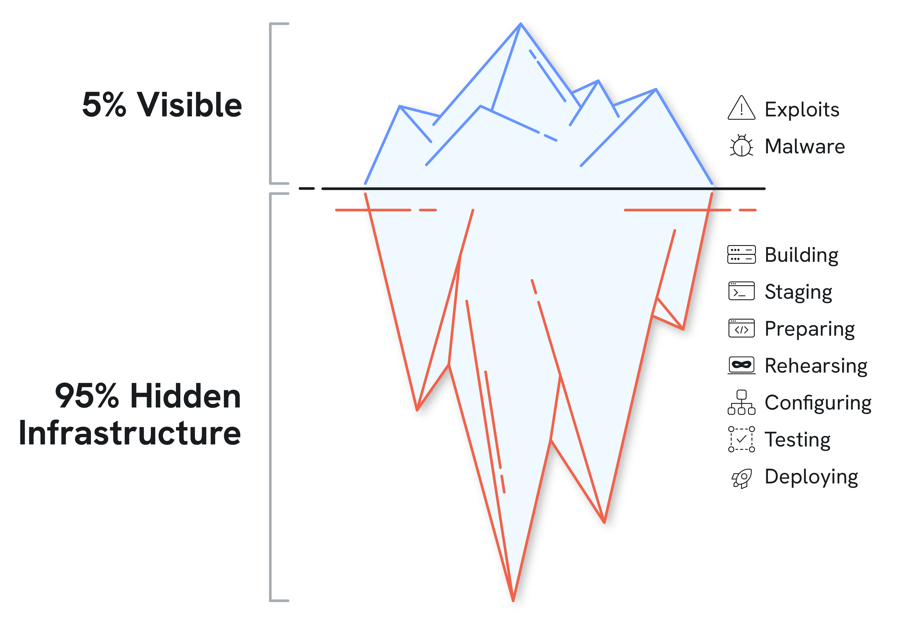
Attackers are moving faster than enterprise.
The security industry is only aware of 5% of attacker infrastructure on any given day.
IT’S A REACTIVE LOOP
Traditional tools only detect attacks after action is taken
IT’S A RACE
Incident Response is a race against a fully deployed adversary
IT MISSES THE HIDDEN 95%
Adversaries operate in the invisible portion of the internet

Slide 3
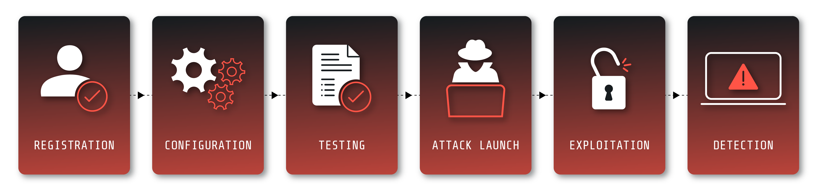
The Core Blind Spot: The Preparation Phase
Silent Push focus:
Management patterns
All security products focus here
These early signals are rarely malicious in isolation.
Their power comes from correlation, timing and reputation.
Current tools classify this infrastructure as “clean” because it hasn’t attacked yet.

Slide 4
The paradigm shift. From reactive to preemptive.
We do not win by reacting faster. We win by seeing earlier.
REACTIVE DEFENSE
The old way
Indicators of Compromise (IOC)
Historical artifacts of attacks that have already occurred. Relying on “patient zero”.
PREEMPTIVE DEFENSE
The new way
Indicators of Future Attack (IOFA)
Reliably indicates future malicious use. Prevention ready.
The goal: Stop the staging. Close the window. Eliminate the “maybe”.

Slide 5
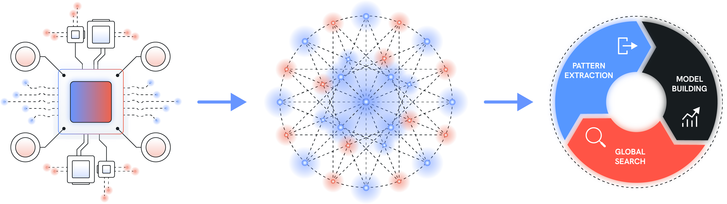
The Context Graph: Architecture of Certainty
We analyse benign, grey and malicious infrastructure alike, because future threats emerge from today’s normal activity.
Collection
Build Context
Operationalize
Passive-Aggressive DNS
(PADNS)
ASN Information
Nameserver Information
WHOIS Data
Traffic Sensors
IP Diversity
Content Hashes
Change Identification
Density Metrics
Frequency Analysis
Reputation Metrics

Slide 6

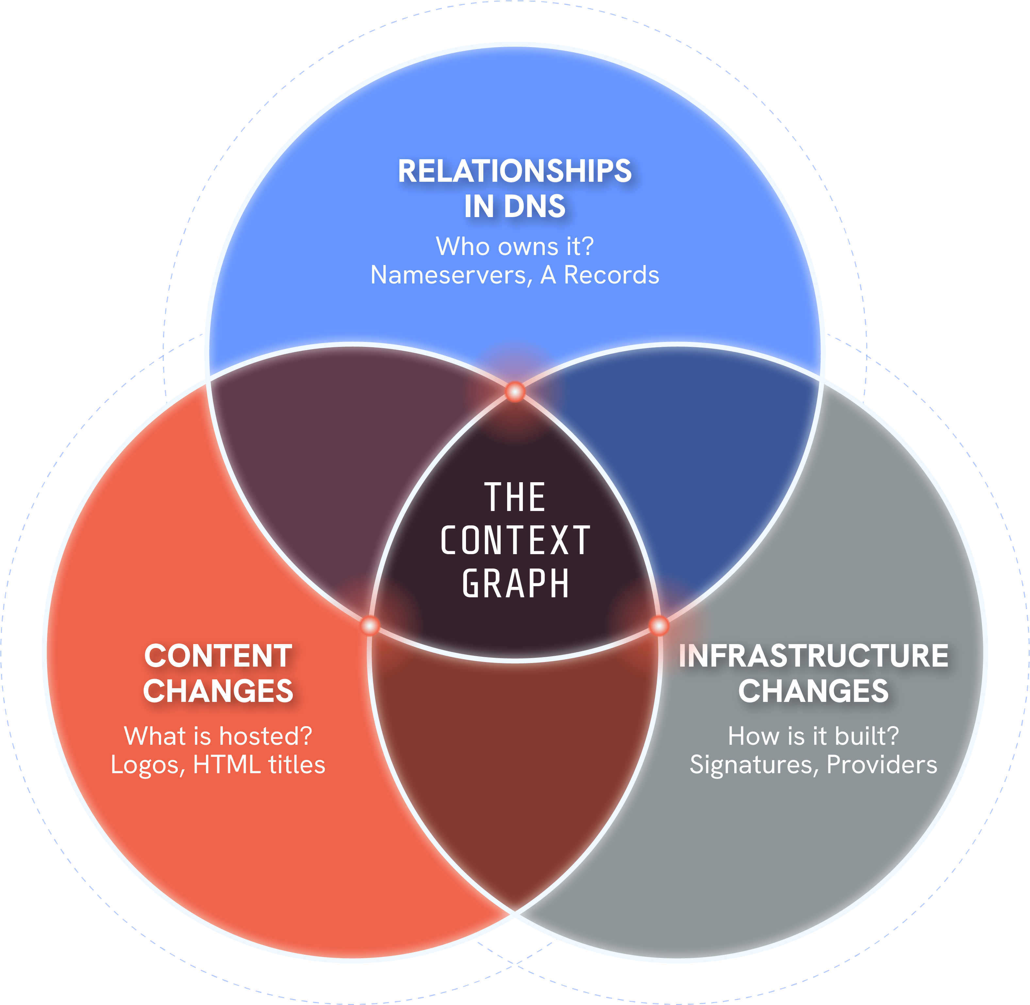
Powered by the Context Graph: mapping the internet’s DNA
CORRELATION, CONTEXT, CLARITY.
Silent Push pre-correlates the global internet dataset, identifying adversary infrastructure as it’s being built.
Moving from probability (guessing) to deterministic certainty (knowing).

Slide 7
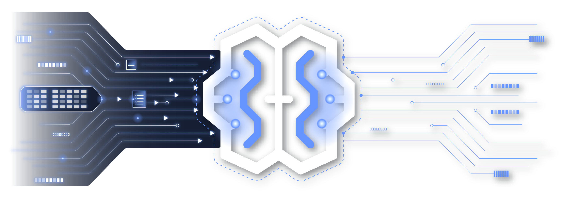
The Context Graph for AI & Agentic Security
Machine Consumption
APIs designed for
automated triage.
Provenance
Clear confidence
signals AI can trust.
The Backbone
Foundational context layer for automated defense.
Key Takeaway: We are embedded upstream in security reasoning, whether human or machine.

Slide 8
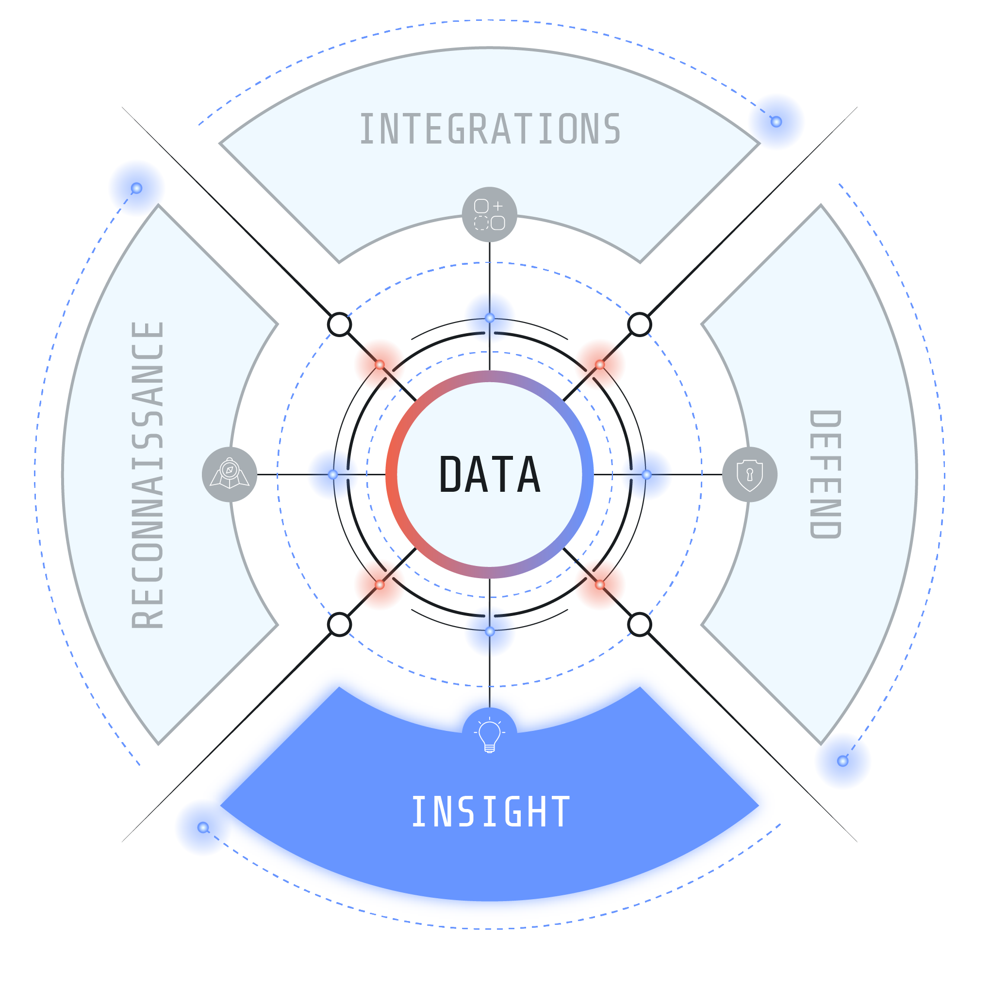
Insight
Strategic pillar 1
ACCELERATE TRIAGE
Turn alerts into answers. Link an IP to
an entire campaign in seconds.
GET INSTANT CONTEXT
Instantly understand WHY infrastructure is related or risky.
FUTURE-PROOF DEFENSES
Get machine-readable context and provenance for AI agents of the future.

Slide 9

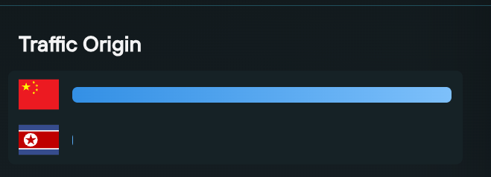


The hidden threat:
Traffic Origin &
Identity Obfuscation
THE CHALLENGE:
Modern adversaries use Residential Proxy-As-A-Service to bypassing geofencing and KYC checks.
STRATEGIC APPLICATIONS:
Unmasking the ‘True’ Origin:
Identifying sanctioned actors masquerading as local users.
Laptop Farms:
Detecting fraudulent employees outsourcing work.
Anti-Money Laundering (AML):
Blocking the Crypto-Fiat Gateway by seeing the true source of funds.

Slide 10
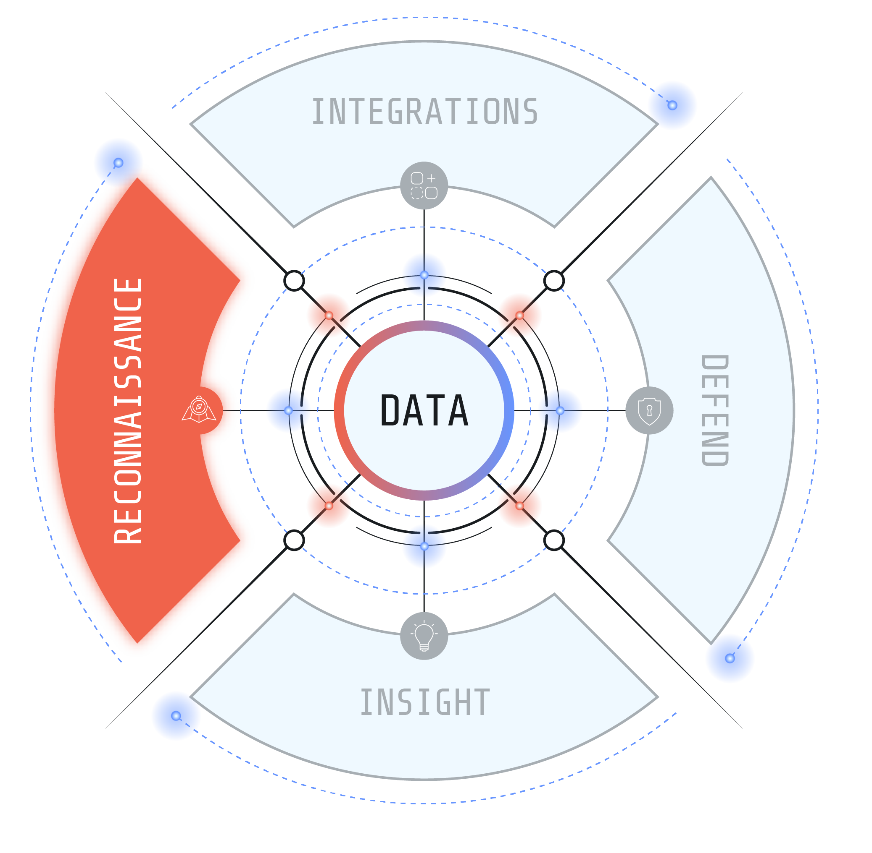
Strategic pillar 2
Reconnaissance
The mission: Find the ”unknown unknowns” by proactively querying the global dataset.
MAP ADVERSARY CAMPAIGNS
Track unknown infrastructure using deep behavioral fingerprinting across 200+ parameters.
PRE-LAUNCH PHISHING DETECTION
Stop brand detection abuse by identifying malicious templates and typo-squatting before the email is sent.
ANALYST PARITY
Giving customers the same visibility as Silent Push’s own threat analysts.

Slide 11
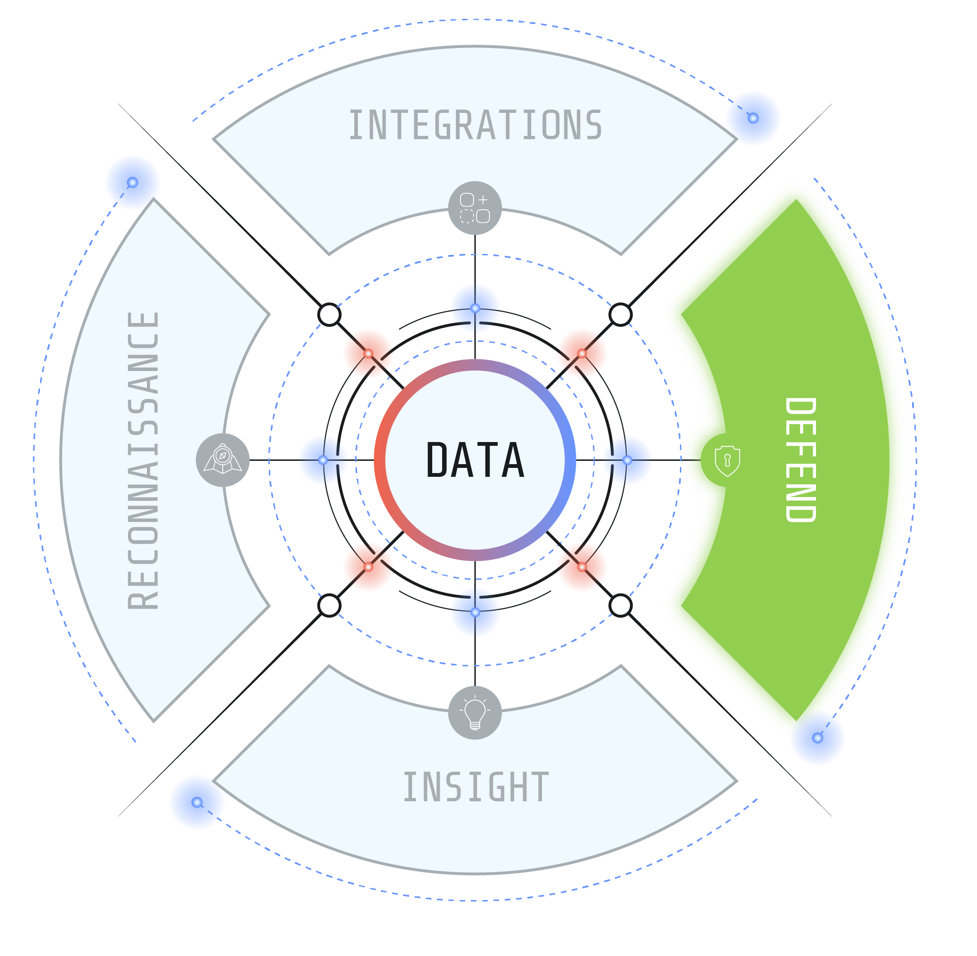
Strategic pillar 3
Defend
THE OUTCOME
The Cyber Dome. Operationalizing high-fidelity IOFAs into direct security actions.
INTEGRATION
SIEM: Enhanced detection rules.
SOAR: Automated blocking workflows.
Firewall/WAF: Preemptive blocklists.
BENEFIT
Feeding data directly into the stack to automate detecting before impact.

Slide 12
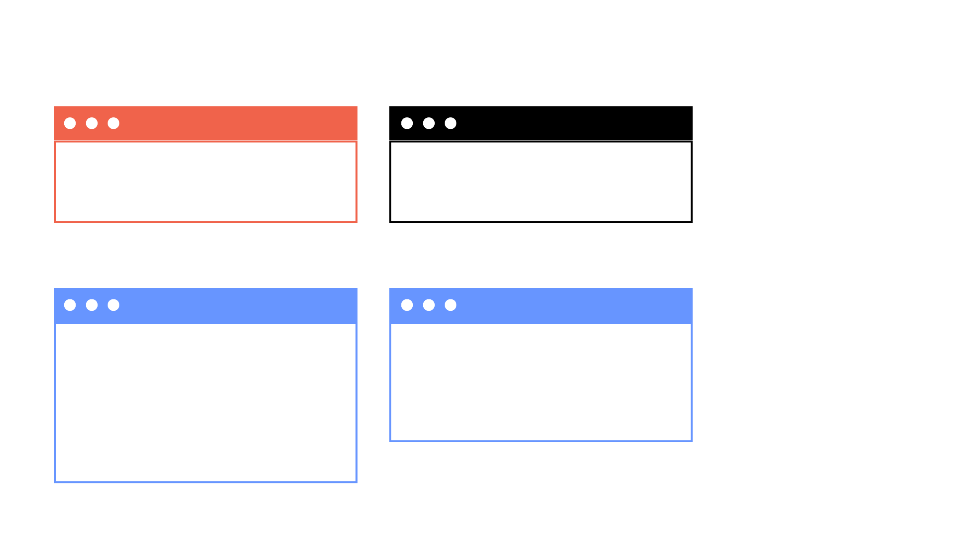
Proof of Vision:
The Salt Typhoon Case Study
Real-world validation of preemptive defense.
The preemptive advantage:
2+ months early warning
May 2025
June 16, 2025
July 2025
October 2025
Silent Push observes domain linked to
pre-weaponization activity.
Silent Push publishes TLP Amber report. Fingerprints identified.
Competitors/victims report initial access.
Public confirmation and validation.

Slide 13
Metrics that matter: Buying time
104 Days
Average Early Detection
Lead Time
300+ Days
Lead time for advanced
APT infrastructure
Comparative lead times
INDICATOR | THREAT TYPE | DETECTION LEAD TIME
FIN7 Domain | APT | 305 days lead time
Lazarus IP | APT | 142 days lead time
PoisonSeed Domain | E-crime group | 132 days lead time

Slide 14
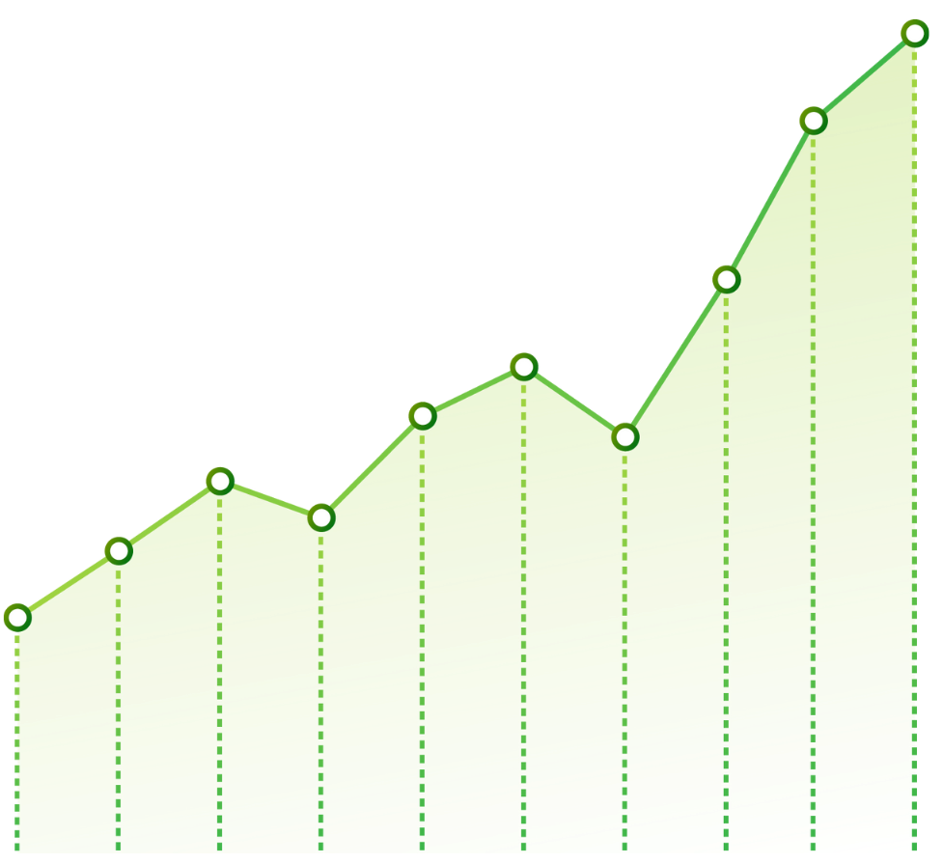


Trusted by the world’s largest organizations
Critical financial and retail infrastructures rely on Silent Push.
The LARGEST
INVESTMENT COMPANY
in the world
The LARGEST
STOCK EXCHANGE
in the world
The LARGEST
RETAILER
in the world

Slide 15
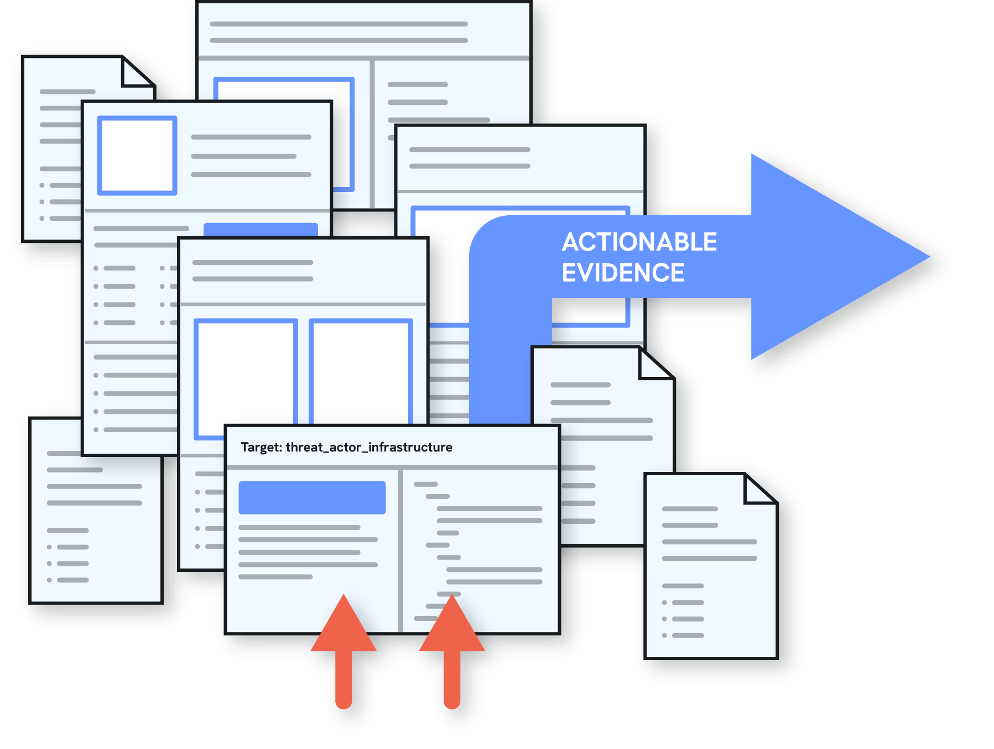
Disrupting the adversary:
Global law enforcement impact
2000+
SILENT PUSH INTELLIGENCE STREAM
Arrests facilitated
Actioned through Interpol via the Cybercrime
Atlas using Silent Push platform access.
US Treasury Sanctions
Official sanctions issued against threat
actors (FUNNULL) based directly on
Silent Push intelligence.

Slide 16




The enterprise advantage
Why leading enterprises are shifting to Silent Push Preemptive Defense
EFFICIENCY
SOC ROI
Prevent, don’t react. Drastically reduce alert volume and false positives by filtering internet noise.
CLARITY
IR ROI
Deterministic data. Eliminate chaos with ‘True’ or ‘False’ attribution rather than probability scores.
SCOPE
CTI and Fraud ROI
Hunt, don’t read.
Cover cyber, fraud and insider threats in a single context graph.

Slide 17






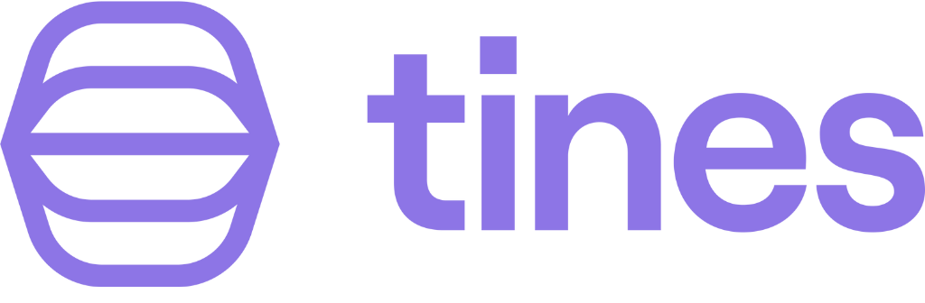




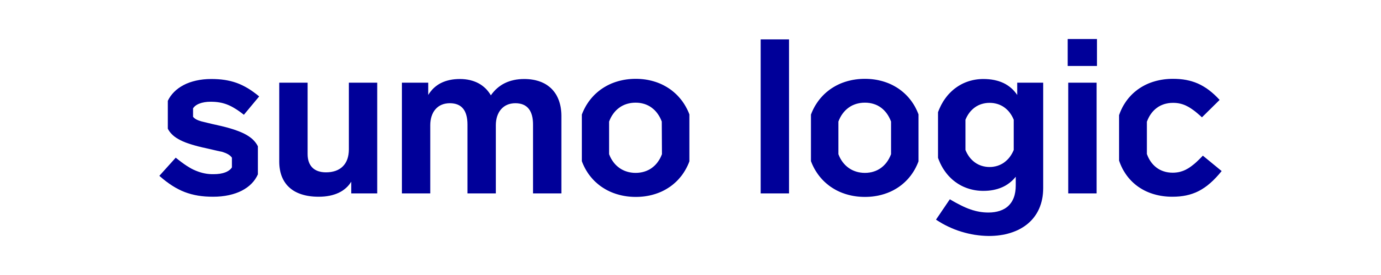



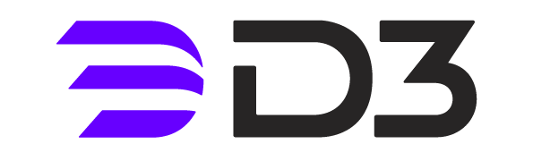




Building the ‘Preemptive Core’:
Operationalizing Preemptive Data
1. IdP:
High-risk login logic.
3. WAF / Firewall:
Blocklists
2. SIEM:
Detection rules
4. Fraud Checks:
Transaction verification

Slide 18

PRE-EMPTIVE.
Stop the staging.
Block infrastructure weeks or months before it ever becomes an IOC.
PROACTIVE.
Close the window.
Automatically neutralize malicious activity the moment it is set up.
DETERMINISTIC.
Eliminate the “maybe”.
Move beyond probability scores to verified binary 'True' or 'False’.
The job is not finished when a pattern is identified. It is finished when you can use it.

Slide 19
It’s about time.
Stop trying to correlate and contextualize data during an attack. We’ve already done it.
Contact Silent Push
Neutralize Before Compromise

