Slide 1

PARTNER ENABLEMENT DECK
2025

Slide 2





Silent Push provides preemptive threat intelligence to reveal adversary infrastructure.
We expose attacker behavior using our unique Indicator Of Future Attack (IOFA) data.
Trusted by Global Enterprise Customers
Complete
view of our
intelligence dataset
Automate
operations with
IOFA™
Proactively
block threats
quickly
Notes:
Introduce how Silent Push solves this problem and that what we output is always COMPLETE, ACCURATE and TIMELY. Compare this to other threat intel that could be stale, out of date, not accuate.

Slide 3


We Own All Our Data
5 years
100%
of Silent Push Data Collection.
We don’t rely on third-party data.
first-party data, collected across the entire internet.
Timestamped
200+
searchable website metadata categories.
data collection to document internet changes over time.
Notes:
Timely, Accurate and Complete first-party data is our core differentiator and sets Silent Push apart from legacy threat intel providers. There is enormous inherent value in a first-party dataset that is purpose built to understand the relationships between different parts of the internet infrastructure. Silent Push enjoys data independence, and all that comes with it - agility, increased trust, accuracy, and speed.
See the Messaging Source Document for more information. There is also a one pager PDF on the value of our data.

Slide 4

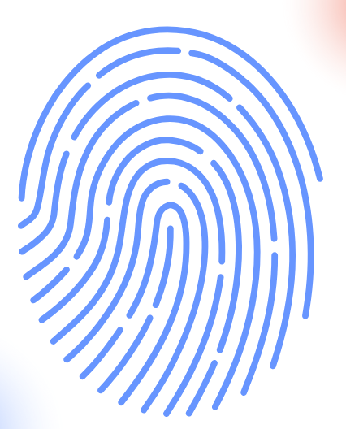



Indicators Of Future Attack (IOFA)
IOFAs are real time, actionable, preemptive indications of attacker behavior and intent.
Identify a group of behaviors
and TTPs
2. Turn into searchable attributes
3. Obtain a complete view of the threat landscape
Phishing
One Day Earlier
Access Brokers
Six Days Earlier
APT Groups
Two Months Earlier
4. Stop known and unknown threats
Notes:
Create a new class of behavior-based intelligence - IOFA
The goal of this is to explain IOFA, how we create them and that IoFA gives earlier detection. If people ask the source, this is from internal benchmarking.
identify a group of attacker behaviors
turn them into searchable attributes
combine them into composite objects
search across everything that exists
find all related infrastructure
defend against upcoming threats

Slide 5






Use Cases and Solutions
Intelligence Feeds
Proactive Threat Hunting
Know First with IOFAs
Brand Impersonation
Defend Against Hidden Attacks
Stack Integration (SIEM, SOAR etc.)
APT, C2 and Infostealer Tracking
Risk and Reputation Scores
Targeted Threat Detection
TTP-Led Cyber Defense
Proprietary Behavioral Fingerprinting
Brand Impersonation
Protect Your Reputation
Automated Spoofing Prevention
Content-based Identification
Takedown Monitoring

Slide 6
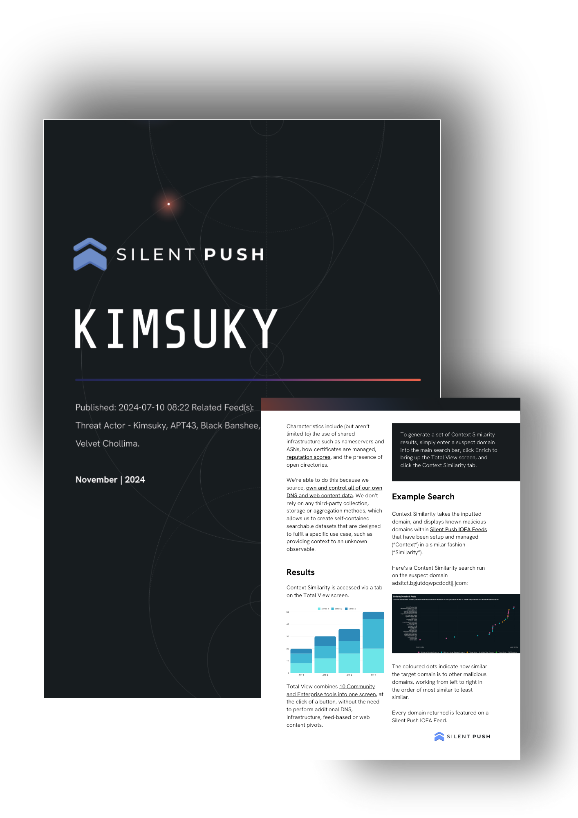
Intelligence On-Demand
Select from a flexible list delivered by our threat intelligence industry experts
Tailored Threat Briefings
Individualized Reports
Prioritized IOFA Updates
Advanced Training and Research
Stay ahead of your adversaries. Strengthen your security team. Make informed decisions faster. Protect against the threats that matter most.

Slide 7
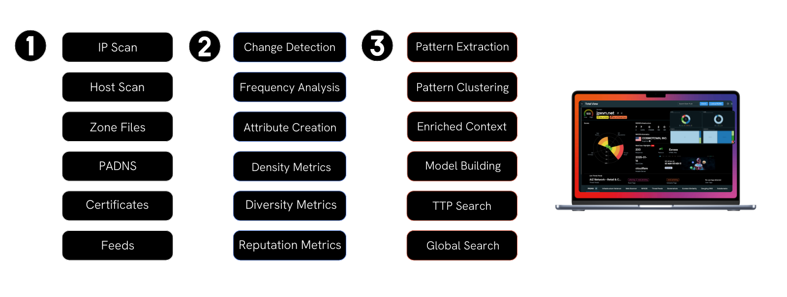
Foundation for IOFA™ Detection
Collection
Analysis
Context
IOFA
Notes:
Timely, Accurate and Complete first-party data is our core differentiator and sets Silent Push apart from legacy threat intel providers. There is enormous inherent value in a first-party dataset that is purpose built to understand the relationships between different parts of the internet infrastructure. Silent Push enjoys data independence, and all that comes with it - agility, increased trust, accuracy, and speed.
See the Messaging Source Document for more information. There is also a one pager PDF on the value of our data.

Slide 8
Silent Push Capabilities in Summary

Slide 9
Silent Push What We Do
We reveal adversary infrastructure by searching across the most timely, accurate, and complete proactive threat intelligence dataset available anywhere in the world.
We allow defenders to focus on stopping threats before they cause a problem while simultaneously reducing operational complexity.
We own all of our data. Most threat intelligence platforms rely on public IOCs, OSINT data, crowdsourced intelligence, and passive DNS sensors to gather intelligence.
Our data is our core differentiator. We provide timely, accurate, and complete datasets that allow security teams to track emerging TTPs and combat pre-weaponized infrastructure.
Threat activity produces patterns. Controlling our own data allows us to add an infinite amount of context and connect the dots to produce operationalized intelligence.
Our console and API expose Indicators of Future Attack (IOFA)—intelligence data that tells security teams where an attack is coming from, rather than where it's been (legacy IOCs).
$4.45M – The average cost of a breach (IBM, 2024).

Slide 10



Silent Push Solutions Summary
Proactive Threat Hunting
Digital Risk Protection
Early Detection Feeds
Track DNS, HTML, and certificate data to expose threats.
Create a behavioral fingerprints of attacker TTPs.
Evaluate risk with custom scoring and campaign insights.
Pivot through billions of data points to map infrastructure.
Stop impersonation campaigns before they're deployed.
Monitor changes to an organization's public DNS presence.
Map out a brand's presence on the internet.
Identify exploitable DNS records and domains in real time.
Ingest threat-specific early detection data into your stack.
Track C2 and APT activity using campaign-specific data.
Monitor additions to ICANN zone files, including ccTLDs.
Get real-time notifications of changes within the IPv4/6 space.

Slide 11
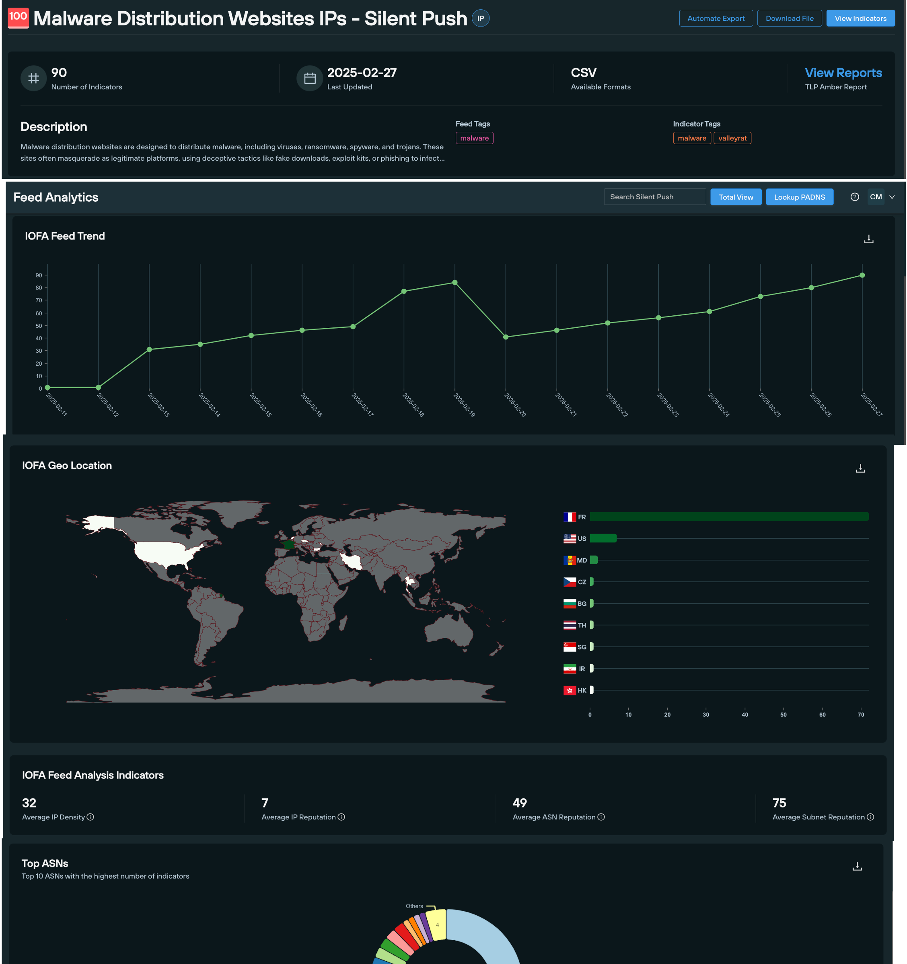
Early Detection Feeds
Threat actors are continually emerging and modifying their infrastructure to avoid detection.
Our Threat Analyst team produce curated threat feeds that can be easily integrated into an existing security stack, either via our console or the Silent Push API.
Early Detection Feeds allow security teams to work smarter with the resources at hand, and deploy an automated approach to threat intelligence workflows.
Our feed management functionality reduces the burden of alert fatigue, eliminates false positives and frees up staff to work on critical tasks such as IR and remediation.

Slide 12
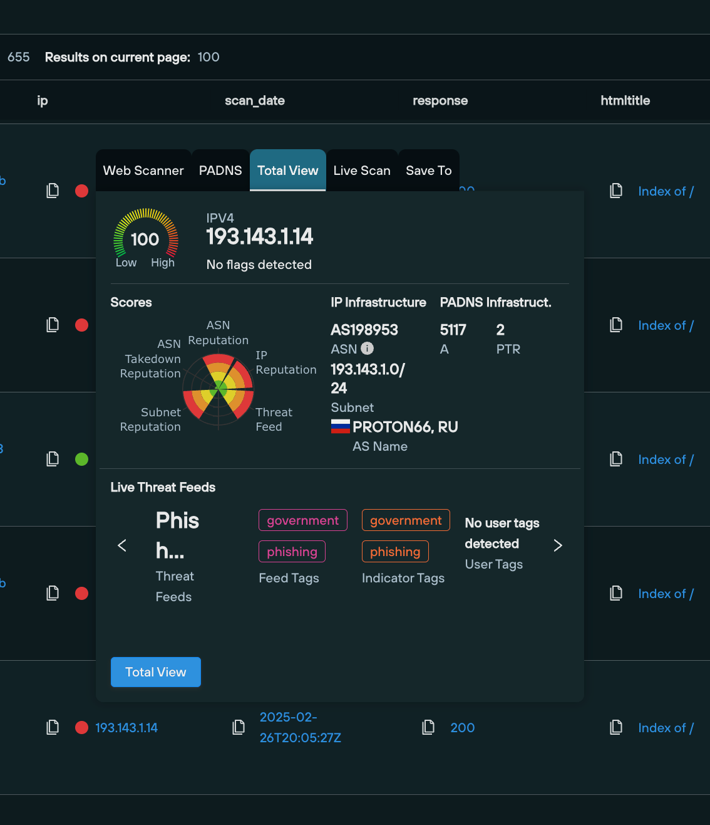
Proactive Threat Hunting
By proactively seeking out emerging threats, organizations can identify and respond before a breach occurs. Silent Push gives Threat Hunters the ability to identify and track malicious infrastructure before it's weaponized.
Threat activity produces patterns. Controlling our own data allows security teams to add an infinite amount of context, and join the dots to produce operationalized intelligence.
Silent Push operates a proprietary scanning, collection and aggregation engine, without third party intervention, that allows threat hunters to correlate the entire global IPv4/6 range (including all DNS records) quickly, and with a higher degree of accuracy.

Slide 13

Sales Conversation and Pitch Hooks
See the Threat Before It Hits – Indicators of Future Attack (IOFA)™
Opening Question: How often do you find yourself reacting to threats instead of proactively stopping them?
[What would the financial impact be if you got breached]
Sales Hook: Traditional threat intelligence tells you where an attack has been—Silent Push tells you where it’s going next. Indicators of Future Attack (IOFA) expose adversary infrastructure before it’s weaponized, allowing you to block threats before they ever reach your infrastructure.

Slide 14

Sales Conversation and Pitch Hooks
Proactive Threat Hunting with Exclusive Intelligence, Not Just OSINT
Opening Question: Do you trust the same threat intelligence data your adversaries have access to?
[What’s the risk imposed on knowing legacy threat intelligence has been acquired by your adversaries]
Sales Hook: Most platforms rely on public IOCs, OSINT, and passive DNS. Silent Push owns its entire dataset, providing high-fidelity intelligence that maps out attacker infrastructure in real time—giving your team an exclusive advantage over emerging threats.

Slide 15

Sales Conversation and Pitch Hooks
Seamless Integration & Automation – Intelligence That Works for You
Opening Question: How easily can your team integrate and operationalize new intelligence feeds into your security stack?
[Could your team achieve better and higher quality results with the automation of higher value threat intelligence feeds being integrated into your tech stack]
Sales Hook: Silent Push delivers curated threat intelligence feeds that seamlessly integrate into your existing security stack via our console or API. Automate threat intelligence workflows, eliminate manual overhead, and let your team focus on analyzing and stopping threats—not just managing feeds.

Slide 16

Sales Conversation and Pitch Hooks
Digital Risk Protection – Stop Brand & Infrastructure Impersonation
Opening Question: How confident are you in detecting adversary-controlled domains before they are weaponized against your organization?
[What would the financial impact be if your brand was used in phishing or financial fraud activities]
Sales Hook: Adversaries register lookalike domains, manipulate DNS records, and exploit weak certificates to impersonate your brand and infrastructure. Silent Push continuously monitors changes to public DNS records, giving your team the visibility to neutralize threats before they become phishing, spoofing, or malware delivery platforms.

Slide 17
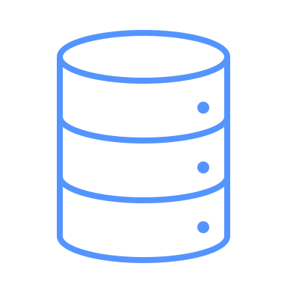
Sales Conversation and Pitch Hooks
Seamless Integration & Automation – Intelligence That Works for You
Opening Question: How easily can your team integrate and operationalize new intelligence feeds into your security stack?
[Could your team achieve better and higher quality results with the automation of higher value threat intelligence feeds being integrated into your tech stack]
Sales Hook: Silent Push delivers curated threat intelligence feeds that seamlessly integrate into your existing security stack via our console or API. Automate threat intelligence workflows, eliminate manual overhead, and let your team focus on analyzing and stopping threats—not just managing feeds.

Slide 18
THANK YOU!
Your personal contact:
Bradley Taylor
Global Partnerships and Alliances btaylor@silentpush.com
+49 159 0189 4132

